Slide 1

Internet
Good evil

Slide 2
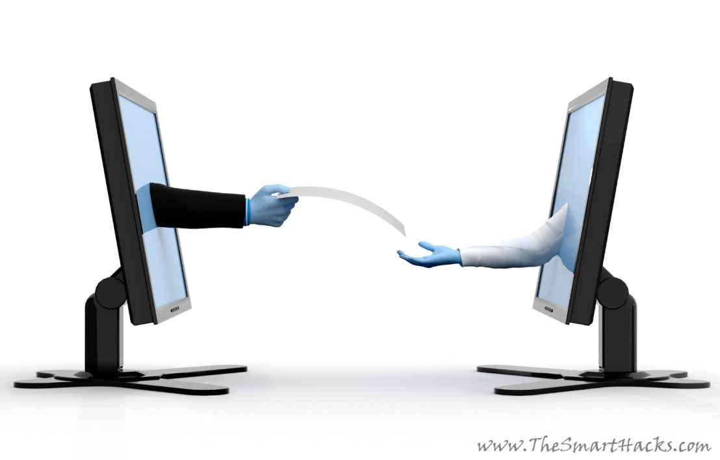

What is internet
Millions of computer around the world are connected to each other to share information through Internet.
Internet stands for international network.
It is generally used as a mean of communicate, and search endless amount of information from unlimited number of sources.

Slide 3
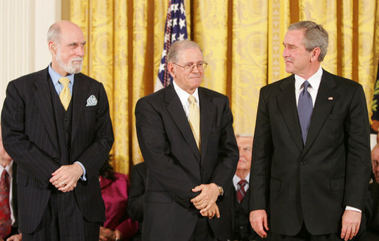
Inventers of internet

Slide 4
Advantages of Internet
It provide information/news on any topic.
It allows us to send and receive message anywhere and anytime.
We can have videos as well as text chat too.
We can buy or sell any product.
We can check exam results.

Slide 5
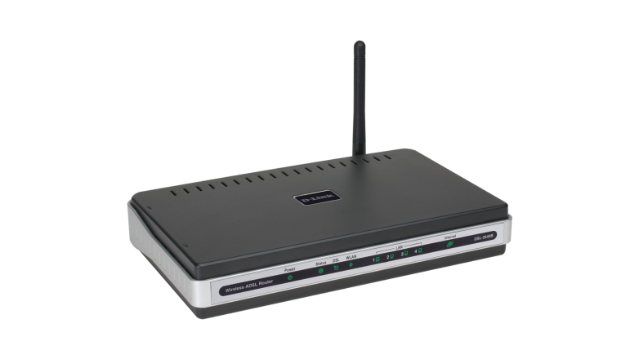
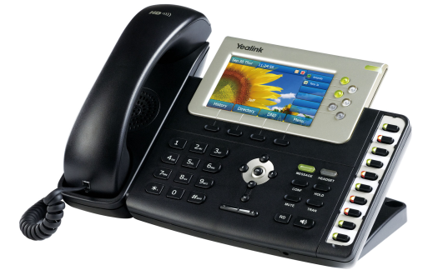

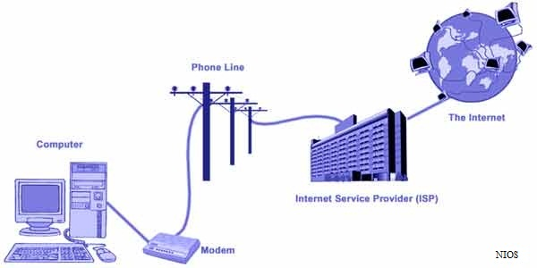
Basic requirements for an internet connection
Modem
Telephone
An internet connection
Web Browser

Slide 6
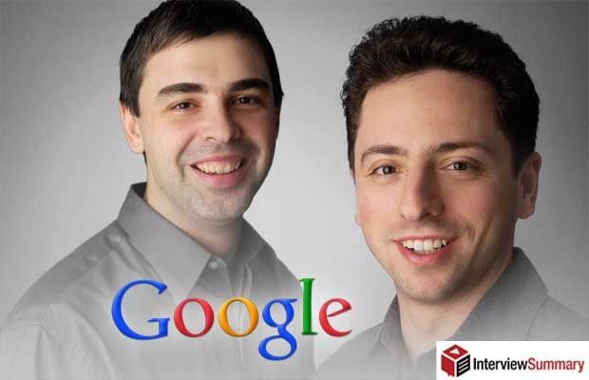
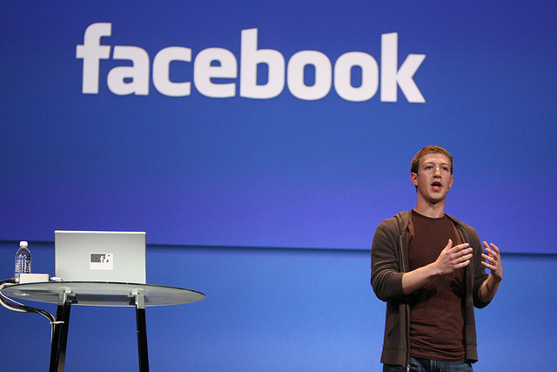
Some famous people related to internet are:-
Larry page and Sergey brin are the founders of google.
Mark Zuckerberg co-founder of facebook.

Slide 7
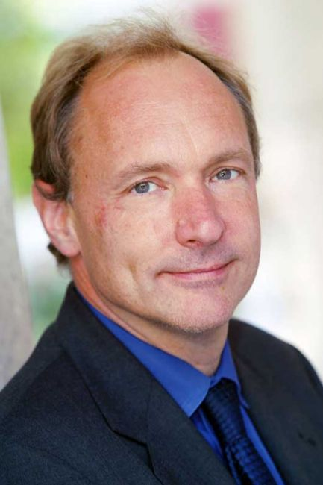
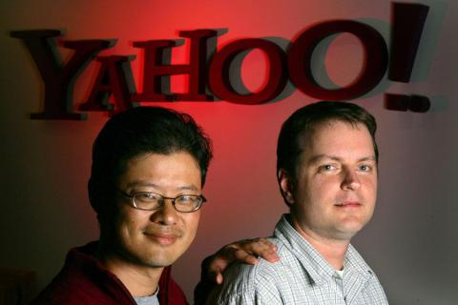
Tim berners lee invented the world wide web (www).
Jerry yang and David filo are the founders of yahoo.

Slide 8
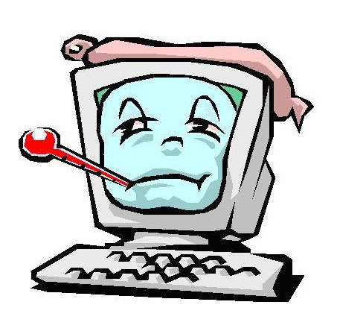
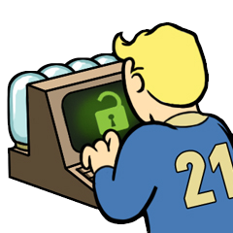
Disadvantages
Easy to waste a lost of time on internet.
Hackers can create viruses that can get into your personal computer and ruin valuable data.
Hackers can use internet for identity theft.
Internet have a lot of ‘cheater’ sites. Many people are trapped into many cases.

Slide 10

Any inquiry

